Slide 1
Ensemble Learning
How to blend your model
COMP 7404 Group Project
Team Members:
Lee Kai Shing 3035562540
Mak Tak Hei 3035420273
Lui Sin Ying Bianca 2010085577
Lo Rocky 3035420077
Chan Wing Hei 3035186243

Slide 2
Overview
References
Introduction
Methodology - An Example
Boosting
+ Random Forest
= Boosted Random Forest
Demo
Experimental Results and Additional Improvements

Slide 3
References
Yohei Mishina, Masamitsu Tsuchiya & Hironobu Fujiyoshi, “Boosted Random Forest” in 2014 International Conference on Computer Vision Theory and Applications (VISAPP), IEEE, 2014.
Qiang Yang, “Ensemble of Classifiers” http://www.cse.ust.hk/~qyang/521/PPT/Ensemble.ppt.
Lee Kai Shing, Mak Tak Hei, Lui Sin Ying Bianca, Lo Rocky & Chan Wing Hei, “COMP7404 Computer Intelligence and Machine Learning Group Project” https://github.com/donaldmak0910/COMP7404.

Slide 4
Introduction -
General Idea of Ensemble Learning (1/3)
Deriving one single perfect model is too hard.
One size does not fit all.
Why not combine multiple models to improve performance?

Slide 5
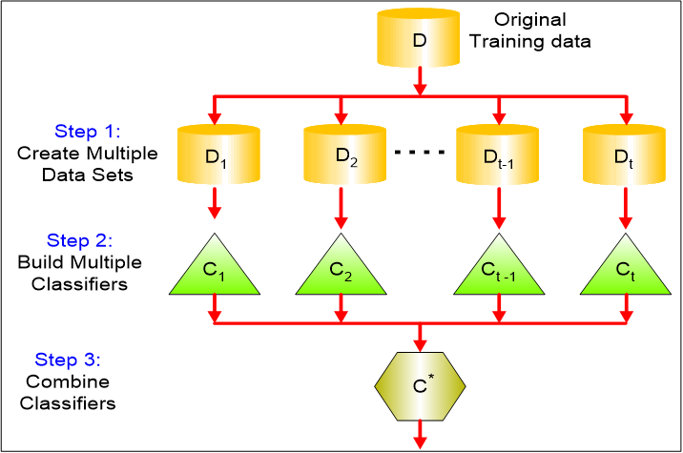
Introduction -
General Idea of Ensemble Learning (2/3)
Notes:
http://www.cse.ust.hk/~qyang/521/PPT/Ensemble.ppt

Slide 6
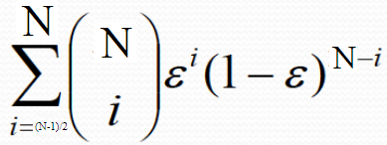
Introduction -
General Idea of Ensemble Learning (3/3)
Why does it work? How well does the ensemble classifier perform?
Assume N classifiers, N is an odd number, and each classifier has an error rate of ɛ.
Assume these classifiers are independent (part of ensemble algorithm).
If taking an unweighted voting approach, then error rate of the ensemble classifier is given by when more than half of all classifiers get it wrong…
If e.g., individual error rate ɛ = 35% and N = 25, the error rate of the ensemble classifier is only 6%, which is much lower than the base.
Notes:
http://www.cse.ust.hk/~qyang/521/PPT/Ensemble.ppt

Slide 7
How?
Questions
How are the classifiers created?
How are the results combined?
High Level Appraoches
Sequential
Generate base classifiers sequentially, “recent” classifiers “learn” from previous ones.
Parallel
Generate base classifiers in parallel, and reduce error by averaging.
Hybrid
Combination of different approaches.
Notes:
Not getting into details. Just going over the existance of these concepts.

Slide 8
Sequential Method - Boosting
“An iterative procedure to adaptively change distribution of training data by focusing more on previously misclassified records...”
In English, on a high level...
First round, train the first classifier with original training data.
Second round, give higher weights to data instances where the first classifier is wrong. With this set of training data with unequal weights, train a new classifier.
Repeat the steps above to get a set of classifiers.
The ensemble/boosted classifier is to combine the predictions of all classifiers, with weights based on individual classifier’s accuracy.
Notes:
http://www.cse.ust.hk/~qyang/521/PPT/Ensemble.ppt

Slide 9
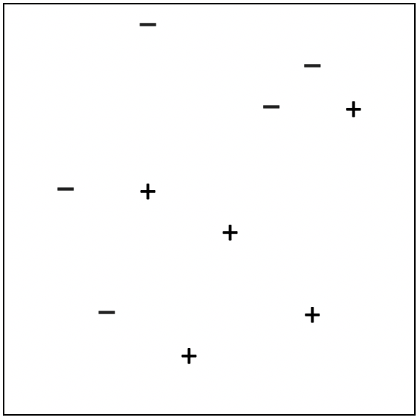
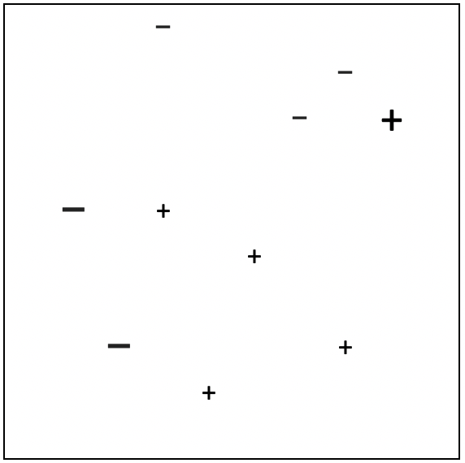
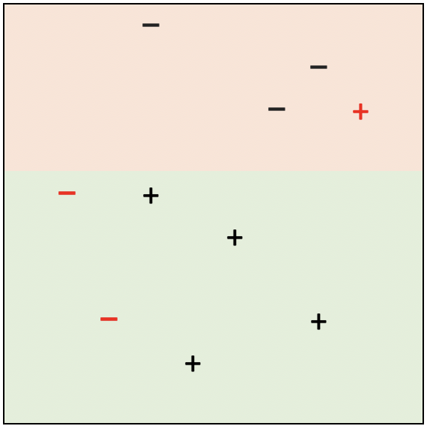
Boosting - Example
D1
D2
Notes:
https://youtu.be/ix6IvwbVpw0

Slide 10


Weighted Cost
Cost function

Slide 11
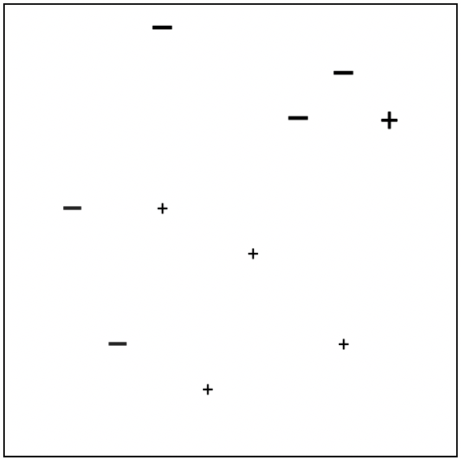
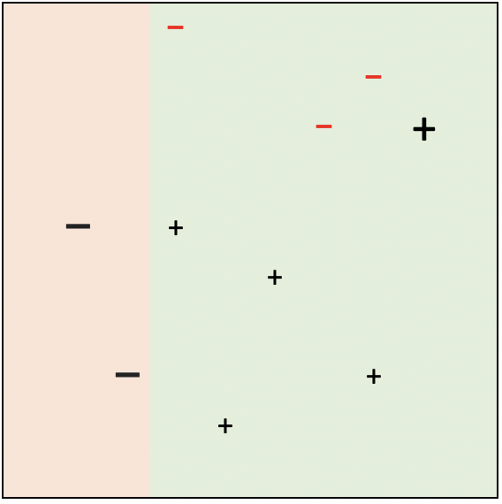
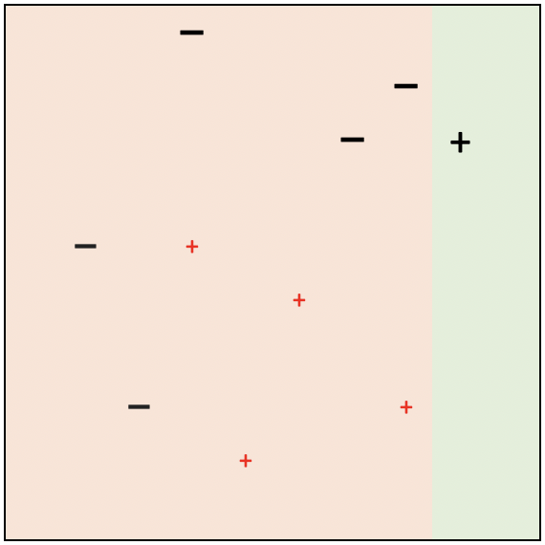
Boosting - Example
D1
D2
D3
Notes:
https://youtu.be/ix6IvwbVpw0

Slide 12
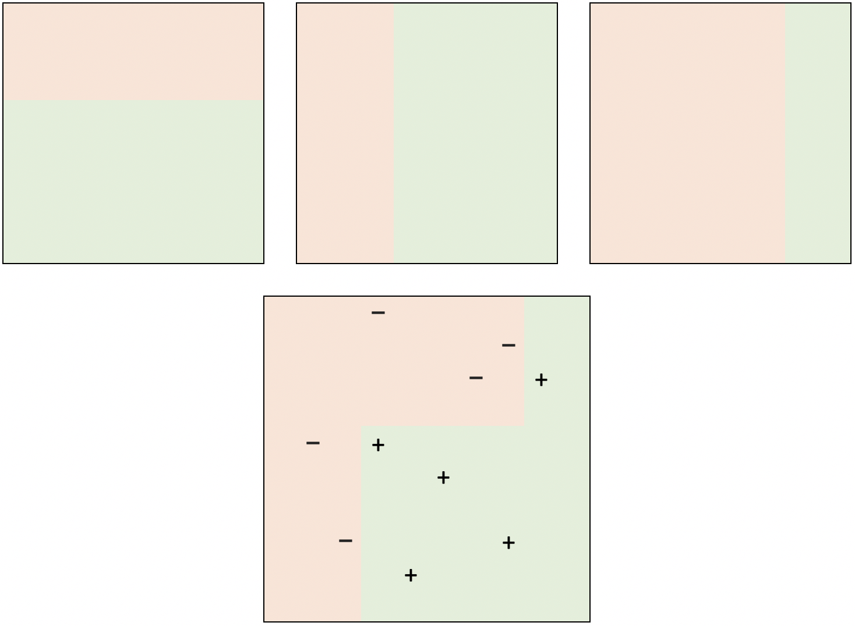
Boosting - Example
Then finally all classifiers are combined.
Famous algorithm: AdaBoost, XGBoost
Weak Classifiers
Strong Classifier

Slide 13
Parallel Method - Random Forest (1/2)
A forest == Many trees :-)
Ensemble method to combine N decision trees which can be built/trained in parallel.
Final prediction is derived by majority vote of all these N decision trees.
Randomness of this method is a result of the following 2 points.
Each tree is trained by a sample of all training data. Not all training data.
Then at each node, best split is calculated based on a random subset of all features, rather than all features.

Slide 14
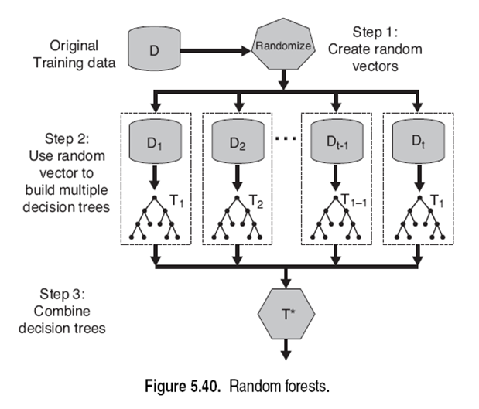
Parallel Method - Random Forest (2/2)
Notes:
http://www.cse.ust.hk/~qyang/521/PPT/Ensemble.ppt

Slide 15

Hybrid - Get the best of both worlds
Boosted Random Forest

Slide 16
Boosted Random Forest - Motivation
Random Forest
Avoids overfitting by random sampling of training data.
Fast, as many decision trees can be trained in parallel.
Stores many or even highly alike decision trees to be accurate.
Not suitable for less capable devices.
Boosting
Less number of classifiers is needed, as each classifier “learned from mistakes” made by previous classifiers.
Tends to overfit, because noise is given more attention.
So why not combine both?
Notes:
https://ieeexplore.ieee.org/document/7294983

Slide 17
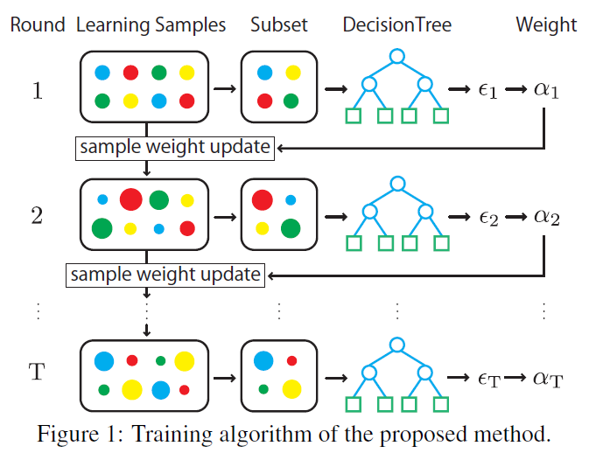
Boosted Random Forest - High Level
Generate a number of trees or a forest by sequentially focusing on the weakness or misclassified samples of classifiers before.
Then, we combine trees by considering their importance in prediction.
Think about a corporation, we need
Generalists
Specialists who can solve problems that generalists cannot do
Boosting is introduced to RF to identify the problems and hire/train the next specialist tree
Notes:
https://ieeexplore.ieee.org/document/7294983

Slide 18
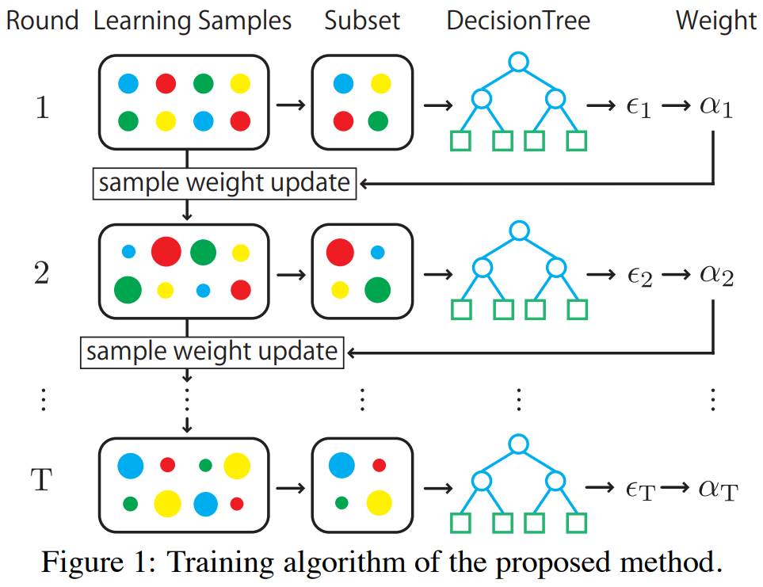




Focus on the misclassifed
samples
The weight of each training sample, w_{i} is initialized to 1/N, where N is the total number of examples.
After each training round, these training samples’ weights are updated…
Wait. What is ⍺? It is a magnifer
Interestingly, weight ⍺_{t} is also used to combine trees later...
Weighted
error rate εt
of tree t
If ⍺>0, the weights of incorrectly predicted samples will become bigger, and vice versa (Boosting!)
if the new tree t is generally improving, εt<0.5 => ⍺>0 => further narrow the focus
Notes:
https://ieeexplore.ieee.org/document/7294983

Slide 19


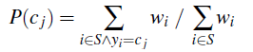
How can sample weight w
affect the training?
Node Splitting in building the next tree
Find the split with highest Information gain
E(S) is entropy
However, P(class j) is using a weighted version using our sample weight w
In English, a feature which can classify previously incorrectly predicted samples is favored during the splitting process => Every tree counts!
Notes:
https://ieeexplore.ieee.org/document/7294983

Slide 20


How to combine trees
What do we know now?
Focus on misclassified samples before by updating sample weights W
How to apply W to entropy calculation and tree training
If we keep looping through 1a and 1b, we can get in total T trees, or a forest.
However, how to combine the forecasts?
Recall that we calculated ⍺t for each tree t. After normalization, ⍺t are actually the weights to combine the forecast
εt => Weighted error rate of tree t
1) If the new tree t is not improving, εt=0.5 => ⍺t=0
2) If the new tree t is improving a lot, εt<<0.5 => ⍺t>>0
2)
Notes:
https://ieeexplore.ieee.org/document/7294983

Slide 21
Randomness
When training each tree,
Randomly select a subset of samples
Randomly select a subset of features
Like general random forest, this mechanism helps to avoid over-fitting
Notes:
https://ieeexplore.ieee.org/document/7294983

Slide 22
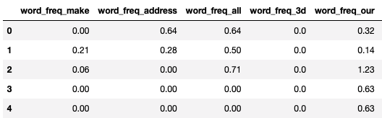
Experimental Results -
Experiment Settings
Procedures:
Split train/test data
For each setting (#trees, max_dpeth):
Repeat 10 times:
Train a new BRF classifier
Give prediction
Measure mean accuracy
Dataset
“Spamebase”
Determine if a message is spam based on a bag-of-words dataset
% of spams:
Training set: 40.28%
Testing set: 36.75%

Slide 23
Demo...

Slide 24
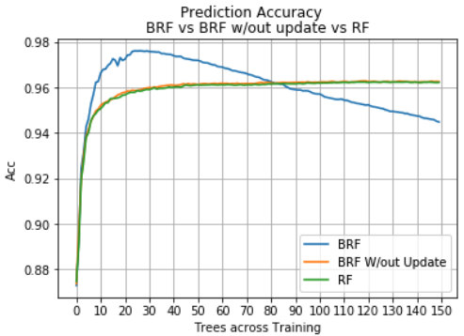
Experimental Results -
Prediction Accuracy
BRF has better optimal accuracy than RF
with only 20 trees ⇒ Boosting!
BRF has better performance with updating weights
Classification powers are not the same for all trees
Problem spotted:
Why performance of BRF drops significantly when #tree grows?

Slide 25
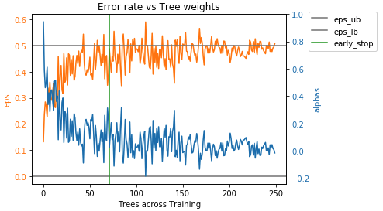
Experimental Results -
Problem Identified
Many trees with high errors are generated at last
even tree weights are small
many small erroneous trees add up and give great influence
Suggestion:
Stop while its still ahead!

Slide 26
Additional Improvement -
Early Stopping
Adding more trees may not be helpful
“Error rate → 0” ⇒ Overfitting ⇒ Improved too much for training set
“Error rate → 1 - 1/n_class” ⇒ Random guess ⇒ Hard to improve more

Slide 27
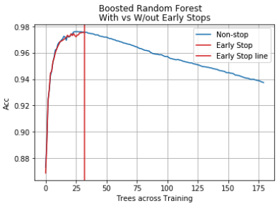
Additional Improvement -
Early Stopping
Improvements:
Improve accuracy
Not all trees are helpful
Shorten training time
Stop before training more unhelpful trees
Reduce number of trees trained by >60~70%

Slide 28
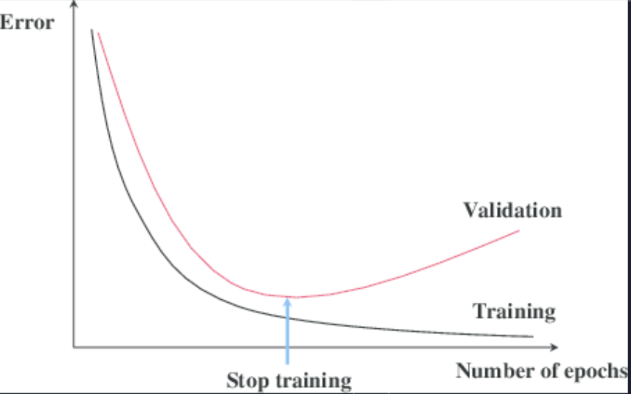
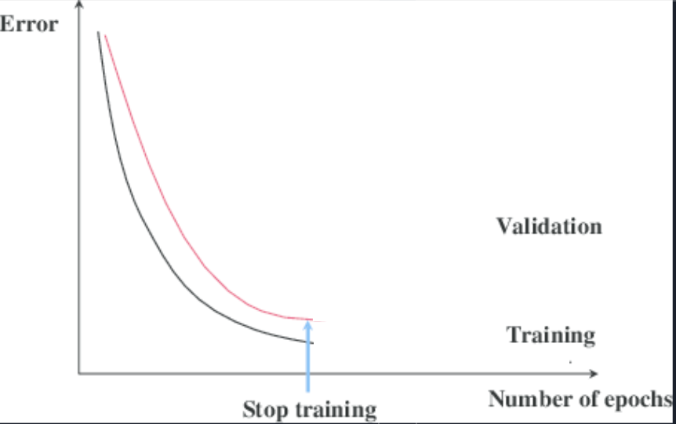
Additional Improvement -
Early Stopping
Common early stopping mechanisms cannot identify optimum until runs after it.
Fluctuation of errors
hard to tell where is optimum on the fly, etc.
Our proposed mechanism can stop right near optimum
Validation-based Early Stopping
Early Stopping with BRF

Slide 29
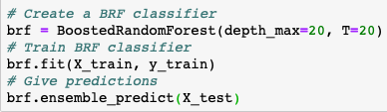
Our Contributions -
Python Package
Not provided by the research team
Easy to use
just like sklearn

Slide 30
Summary
Ensemble Learning
Boosted Random Forest (BRF) has much better performance than the others in terms of accuracy and execution time. (Accuracy=97.6%)
With BRF and Early Stopping technique the number of trees used is significantly reduced by 75% when compared with RF with much better accuracy. (97.5% vs 96.2%)
The enhanced version of the ML algorithm has been consolidated into one python module (BoostedRandomForest) in order to facilitate the reuse and application.

